Slide 1
Learning Objective
I will be able to determine the derivative of a function using first principals
Success Criteria
At the end of the lesson, I will be able to:
Determine the derivative of a function using first principals

Slide 2


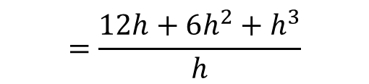
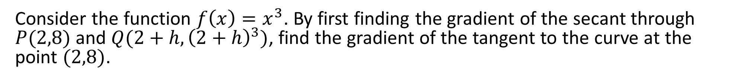
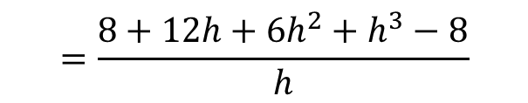
Guided Practice
Consider the function $f\left(x\right)=x^{3}$. By first finding the gradient of the secant through
$P(2,8)$ and $Q(2+h,{\left(2+h\right)}^{3})$, find the gradient of the tangent to the curve at the point $(2,8)$.
Gradient of $PQ=\frac{{\left(2+h\right)}^{3}−8}{2+h−2}$
$$=\frac{8+12h+6h^{2}+h^{3}−8}{h}$$
$$=\frac{12h+6h^{2}+h^{3}}{h}$$
$$=12+6h+h^{2}$$
Gradient of the tangent line at $\left(2,8\right)=\lim_{h→0}{12+6h+h^{2}}=12$

Slide 3
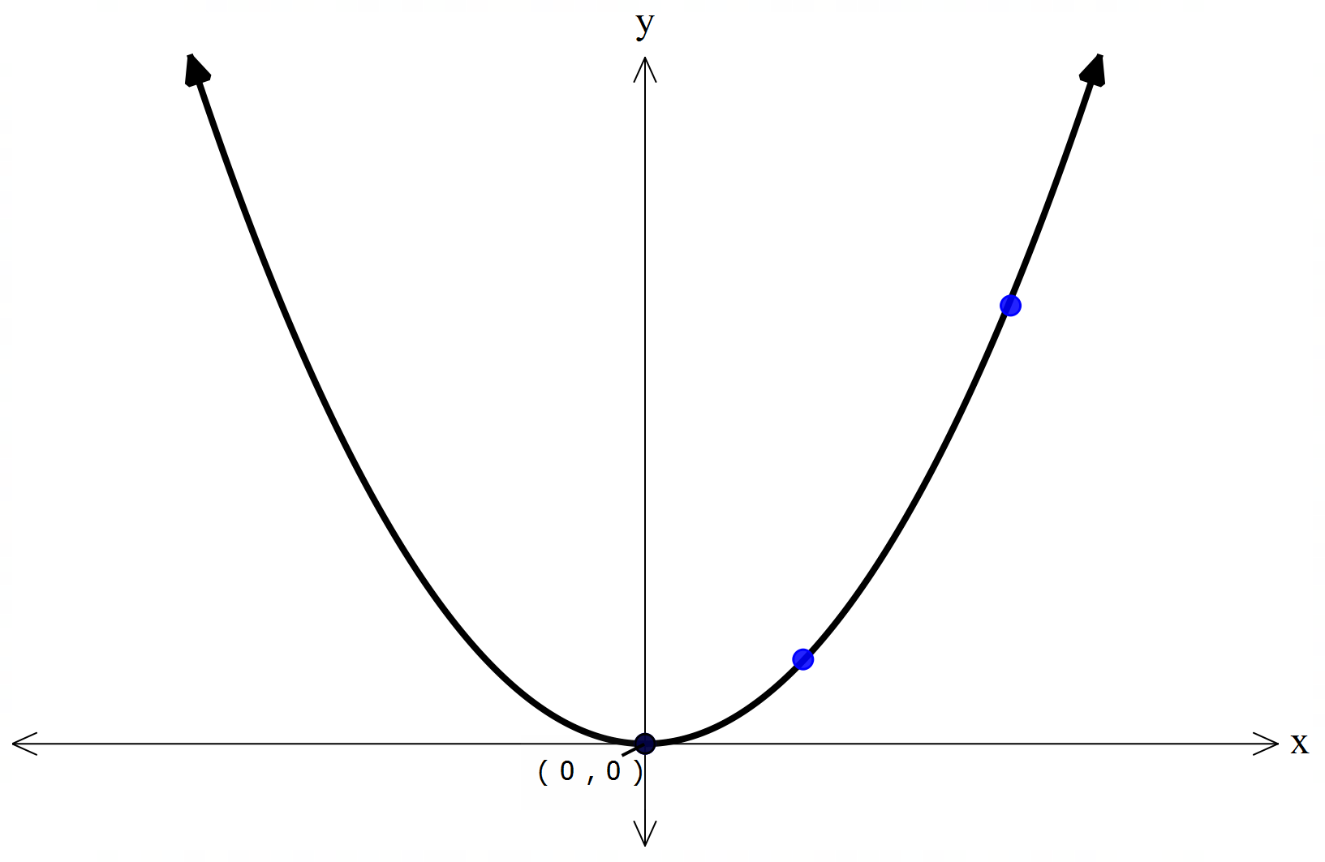




Derivative by First Principles
Activating Prior Knowledge
Consider the function $f\left(x\right)=x^{2}$
Q
We can determine the derivative of function by evaluating the limit ($eg.as h→0)$.
$$This is called the differentiation by first principles$$
P
Differentiation by first principle is denoted by$f′(x)$
$$f^{′}\left(x\right)=\lim_{h→0}\frac{f\left(x+h\right)−f(x)}{x+h−x}$$
$$=\lim_{h→0}\frac{f\left(x+h\right)−f(x)}{h}$$

Slide 4
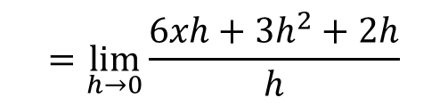
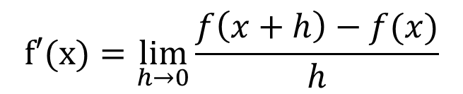
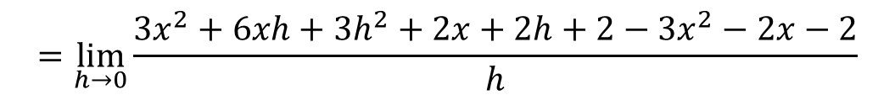
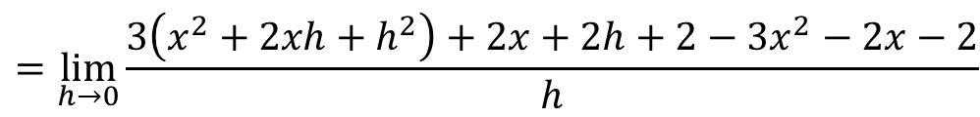

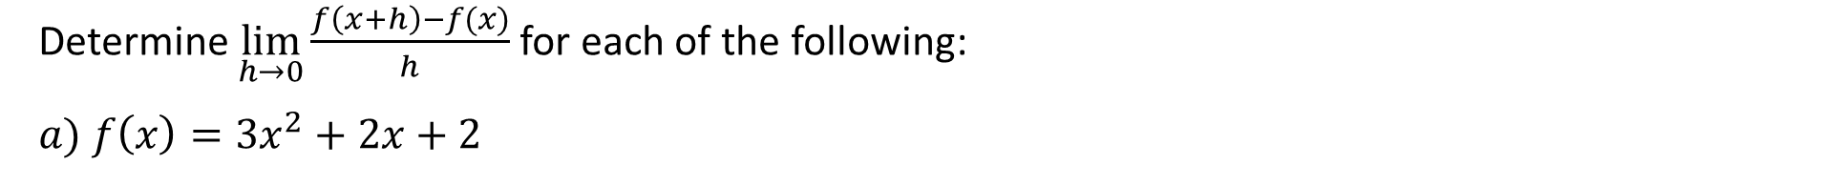

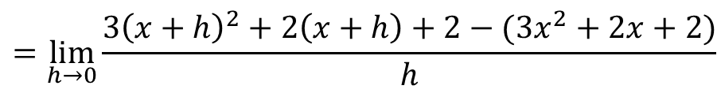
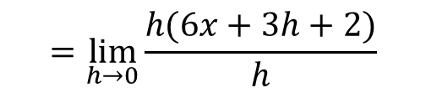
Guided Practice
Determine $\lim_{h→0}{\frac{f\left(x+h\right)−f(x)}{h}}$ for each of the following:
$$a) f\left(x\right)=3x^{2}+2x+2$$
$$f′(x)=\lim_{h→0}{\frac{f\left(x+h\right)−f(x)}{h}}$$
$$=\lim_{h→0}{\frac{3{\left(x+h\right)}^{2}+2\left(x+h\right)+2−(3x^{2}+2x+2)}{h}}$$
$$=\lim_{h→0}{\frac{3\left(x^{2}+2xh+h^{2}\right)+2x+2h+2−3x^{2}−2x−2}{h}}$$
$$=\lim_{h→0}{\frac{{3x}^{2}+6xh+{3h}^{2}+2x+2h+2−3x^{2}−2x−2}{h}}$$
$$=\lim_{h→0}{\frac{6xh+{3h}^{2}+2h}{h}}$$
$$=\lim_{h→0}{\frac{h(6x+3h+2)}{h}}$$
$$=\lim_{h→0}{6x+2h+2}$$
$$=6x+2$$

Slide 5
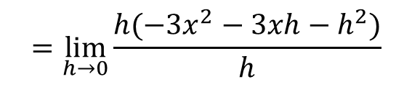
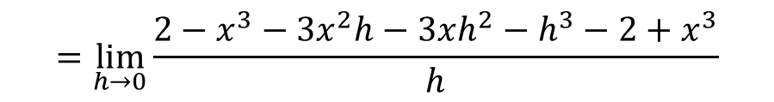
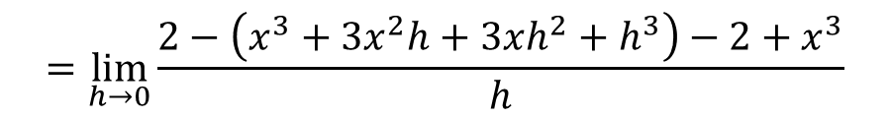
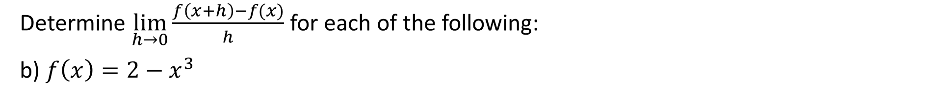

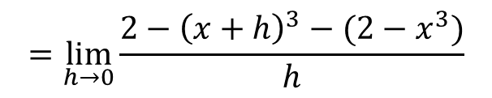

Guided Practice
Determine $\lim_{h→0}{\frac{f\left(x+h\right)−f(x)}{h}}$ for each of the following:
b) $f\left(x\right)=2−x^{3}$
$$f′(x)=\lim_{h→0}{\frac{f\left(x+h\right)−f(x)}{h}}$$
$$=\lim_{h→0}{\frac{2−{\left(x+h\right)}^{3}−(2−x^{3})}{h}}$$
$$=\lim_{h→0}{\frac{2−\left(x^{3}+3x^{2}h+3xh^{2}+h^{3}\right)−2+x^{3}}{h}}$$
$$=\lim_{h→0}{\frac{2−x^{3}−3x^{2}h−3xh^{2}−h^{3}−2+x^{3}}{h}}$$
$$=\lim_{h→0}{\frac{h(−3x^{2}−3xh−h^{2})}{h}}$$
$$=\lim_{h→0}{−3x^{2}−3xh−h^{2}}$$
$$=−3x^{2}$$

Slide 6


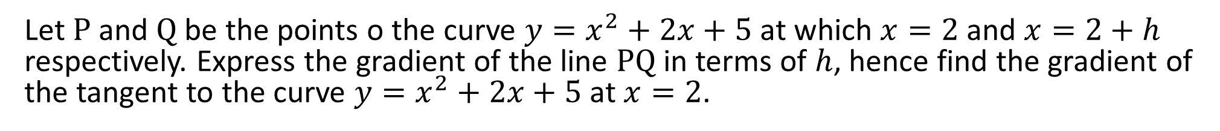
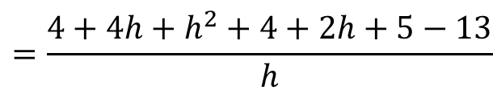
Guided Practice
Let $P$ and $Q$ be the points o the curve $y=x^{2}+2x+5$ at which $x=2$ and $x=2+h$ respectively. Express the gradient of the line $PQ$ in terms of $h$, hence find the gradient of the tangent to the curve $y=x^{2}+2x+5$ at $x=2$.
Gradient of $PQ=\frac{{\left(2+h\right)}^{2}+2\left(2+h\right)+5−({\left(2\right)}^{2}+2\left(2\right)+5)}{2+h−2}$
$$=\frac{4+4h+h^{2}+4+2h+5−13}{h}$$
$$=\frac{h^{2}+6h}{h}$$
$$=h+6$$
Gradient of the tangent line at $x=2 =\lim_{h→0}{h+6}=6$

Slide 7
Independent Practice
Complete Cambridge Ex 4A

